Slide 1
4. Supervised Learning (III)
IT 348/448

Slide 2
Topics
Model evaluation

Slide 3
Model Evaluation
Evaluation metrics: How can we measure accuracy?
Use validation test set of class-labeled tuples instead of the training set when assessing the accuracy
Methods for estimating a classifier’s accuracy:
Holdout method, random subsampling
Cross-validation

Slide 4
Classifier Evaluation Metrics: Confusion Matrix
Confusion Matrix:
Actual class\Predicted class | yes | no
yes | True Positives (TP) | False Negatives (FN)
no | False Positives (FP) | True Negatives (TN)
Example of Confusion Matrix:
Actual class\Predicted class | buy_computer = yes | buy_computer = no | Total
buy_computer = yes | 6954 | 46 | 7000
buy_computer = no | 412 | 2588 | 3000
Total | 7366 | 2634 | 10000
Given m classes, an entry, CM_{i,j} in a confusion matrix indicates # of tuples in class i that were labeled by the classifier as class j
May have extra rows/columns to provide totals
4

Slide 5
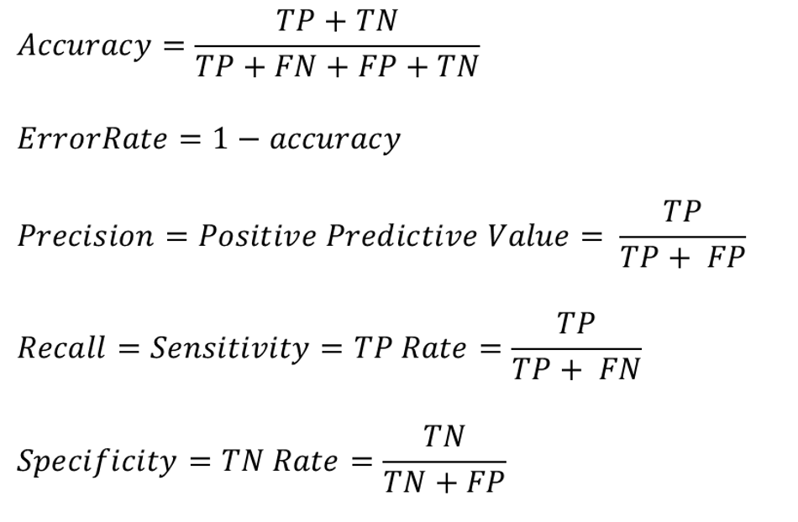
Measures of Classification Performance
Confusion Matrix:
 | PREDICTED CLASS
ACTUAL CLASS |  | Yes | No
 | Yes | TP | FN
 | No | FP | TN
A\P | yes | no
yes | TP | FN | P
no | FP | TN | N
 | P’ | N’ | All

Slide 6
Classifier Evaluation Metrics: Accuracy, Error Rate, Sensitivity and Specificity
A\P | yes | no
yes | TP | FN | P
no | FP | TN | N
 | P’ | N’ | All
Class Imbalance Problem:
One class may be rare, e.g. fraud, or HIV-positive
Significant majority of the negative class and minority of the positive class
Sensitivity: True Positive recognition rate
Sensitivity = TP/P
Specificity: True Negative recognition rate
Specificity = TN/N
Classifier Accuracy, or recognition rate: percentage of test set tuples that are correctly classified
Accuracy = (TP + TN)/All
Error rate: 1 – accuracy, or
Error rate = (FP + FN)/All
6

Slide 7
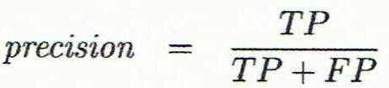
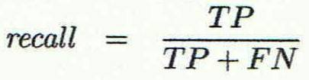
Classifier Evaluation Metrics: Precision and Recall, and F-measures
Precision: exactness – what % of tuples that the classifier labeled as positive are actually positive
Recall: completeness – what % of positive tuples did the classifier label as positive?
Perfect score of precision and recall is 1.0
Inverse relationship between precision & recall exists.
A\P | yes | no
yes | TP | FN | P
no | FP | TN | N
 | P’ | N’ | All
7

Slide 8
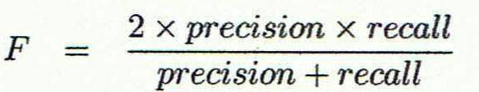
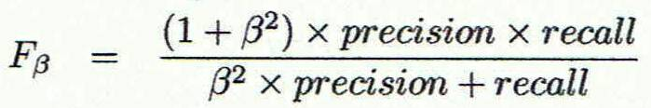
Classifier Evaluation Metrics: Precision and Recall, and F-measures
F measure (F₁ or F-score): harmonic mean of precision and recall
F_{ß}: weighted measure of precision and recall
A\P | yes | no
yes | TP | FN | P
no | FP | TN | N
 | P’ | N’ | All
8

Slide 9
Classifier Evaluation Metrics Example
Actual Class\Predicted class | cancer = yes | cancer = no | Total | Recognition(%)
cancer = yes | 90 | 210 | 300 | 30.00 (sensitivity)
cancer = no | 140 | 9560 | 9700 | 98.56 (specificity)
Total | 230 | 9770 | 10000 | 96.40 (accuracy)
Precision = 90/230 = 39.13%
Recall = 90/300 = 30.00%
Accuracy = (90 + 9560) / 10000 = 0.96 = 96%
Sensitivity = TP/P = 90/300 = 0.3 = 30%
9

Slide 10
Evaluating Classifier Accuracy
Holdout
Cross-Validation Methods
Leave-one-out

Slide 11
Holdout Method
Given data is randomly partitioned into two independent sets
Training set (e.g., 2/3) for model construction
Test set (e.g., 1/3) for accuracy estimation

Slide 12
Cross-validation
Cross-validation avoids overlapping test sets
First step: data is split into k subsets of equal size
Second step: each subset in turn is used for testing and the remainder for training
Cross-validation (k-fold, where k = 10 is most popular)
Randomly partition the data into k mutually exclusive subsets, each approximately equal size
At the i-th iteration, use D_{i} as a test set and others as a training set
The error estimates are averaged to yield an overall error estimate

Slide 13
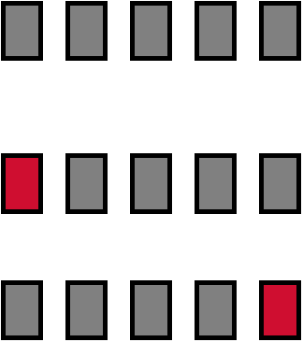
Cross-validation Example
Break up data into groups of the same size
Hold aside one group for testing and use the rest to build model
Repeat
Test
13

Slide 14
Stratified cross-validation
Often the subsets are stratified before the cross-validation is performed
Folds are stratified so that class distribution in each fold is approximately the same as that in the initial data

Slide 15
Stratified cross-validation
Standard method for evaluation: stratified ten-fold cross-validation
Why ten?
Extensive experiments have shown that this is the best choice to get an accurate estimate
Even better: repeated stratified cross-validation
E.g. ten-fold cross-validation is repeated ten times and results are averaged (reduces the variance)

Slide 16
Leave-One-Out cross-validation
Leave-One-Out: a particular form of cross-validation:
Set number of folds to number of training instances
I.e., for n training instances, build classifier n times
k folds where k = # of tuples, for small sized data

Slide 17
Leave-One-Out cross-validation
Makes best use of the data
Involves no random subsampling
Very computationally expensive
stratification is not possible
It guarantees a non-stratified sample because there is only one instance in the test set!

Slide 18
In Class Exercise 4: Example
A | PREDICTED CLASS
ACTUAL CLASS |  | Class=Yes | Class=No
 | Class=Yes | 60 | 80
 | Class=No | 240 | 300
B | PREDICTED CLASS
ACTUAL CLASS |  | Class=Yes | Class=No
 | Class=Yes | 350 | 100
 | Class=No | 200 | 400
Precision =
Recall =
Accuracy =
Sensitivity =
Specificity =
Precision =
Recall =
Accuracy =
Sensitivity =
Specificity =

Slide 19
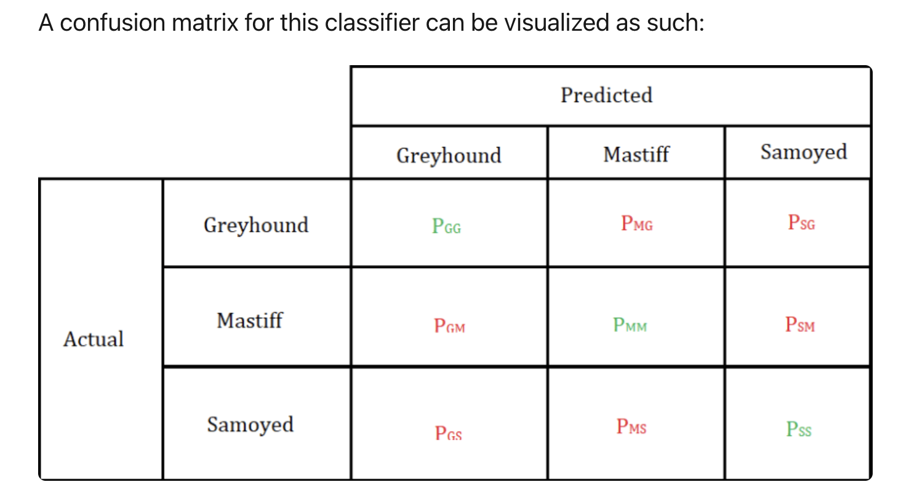
For three classes
https://dev.to/overrideveloper/understanding-the-confusion-matrix-264i

Slide 20
Readings (references)
Classification:
Chapters 3 & 4 (by Geron)
"Classifications_Basic"
Chapter 8 (by Jiwei Han)

